Slide 1
UMET9G-30-1 Accounting & Finance for Decision Making Capital Structure - Debt

Slide 2

Recap
Last week we covered:
Fundamentals of Capital structure
Why the capital structure matters
Main Sources of finance
Pro’s and con’s of different options
How firms choose between them
Notes:
NOTE TO STUDENTS: Please see last weeks lecture slides and make sure you review them so that you understand how

Slide 3
Learning Outcomes
Debt as a source of Long Term Finance
Understanding the key components of Bonds and relevant calculations
Understanding the YTM of a bond
Sources of debt finance

Slide 4
Recap: Role of Finance in Corporations
The three decisions of financial management are:
Question: How does a financial manager choose the appropriate financing method to raise capital for profitable projects which create value?
Corporate Finance
Investment Decision
Financing Decision
Liquidity

Slide 5
Recap: Sources of Finance
Equity Finance
Debt Finance
Bank loan
Bond
Lease
Retained Earnings
Rights issue
Issue of new shares to new investors
Sources of Long Term Finance
Preference share finance
Other sources finance
Fixed dividend payment
Small company financing
Bank loan/overdraft
Retained earnings
Business angels/venture capital funding

Slide 6
Recap: Equity vs Debt
 | Debt | Equity
Yearly Obligations | Fixed Claim in form of: Interest payments Coupon payments | Residual Claim in form of: Dividend payments (not fixed)
Tax Benefits | Tax Deductible | Not Tax Deductible
Priority | Highest Priority | Lowest Priority
Repayment | Fixed Maturity | Infinite
Management Influence | No Management Control, but may impose restrictions eg disposal | Management Control – votes. Possibility of takeover bids
Arrangement | Relatively easy, low issue costs | Time consuming, higher issue costs for underwriting and distributing shares
Other | Debtholder may impose restrictions. High debt level insolvency risk | Public scrutiny and accountability, enhanced status. Cost of reporting.
Notes:
Debt – impose restrictions – may require debt holders permission to dispose of secured assets, may prohibit further raising of debt finance, may have power to veto new investments they consider too risky

Slide 7
Rceap: Debt
Debt finance is where an investor receives a guaranteed return each year on the capital invested, normally in the form of interest payments.
A company must pay interest to the providers of debt finance BEFORE paying dividends to preference shareholders.
The interest payable is tax deductible.
Main types of finance to be aware of are:
Bank Loan
Leasing
Straight bond
Convertible bond
Zero coupon bond
Unsecured bond

Slide 8
SoFP – what about debt?
Group balance sheet
 | 26 February | 27 February
 | 2022 | 2021^{(a)}
 | £m | £m
Non-current assets
Goodwill and other intangible assets | 5,360 | 5,393
Property, plant and equipment | 17,060 | 16,945
Other investments^{(b)} | 1,253 | 763
Trade and other receivables | 159 | 170
Deferred tax assets | 85 | 552
Current assets
Other investments^{(b)} | 226 | 178
Inventories | 2,339 | 2,069
Trade and other receivables | 1,263 | 1,263
Derivative financial instruments | 69 | 37
Cash and cash equivalents | 2,345 | 2,510
Current liabilities
Trade and other payables | (9,181) | (8,399)
Borrowings | (725) | (1,080)
Lease liabilities | (547) | (575)
Current tax liabilities | (11) | (79)
Non-current liabilities
Trade and other payables | (53) | (109)
Borrowings | (6,674) | (6,188)
Lease liabilities | (7,411) | (7,827)
Deferred tax liabilities | (910) | (48)
Equity
Share capital | 484 | 490
Share premium | 5,165 | 5,165
Other reserves | 3,079 | 3,183
Retained earnings | 6,932 | 3,239
Total equity
A snapshot of a firm’s financial position at a certain time (the Assets and the Liabilities and Equity), usually at the end of the fiscal year. The two side ‘balance’.
Notes:
Depending on the debt’s maturity.
Current Liabilities:
This includes short-term debt, such as bank overdrafts, loans due within a year, and the current portion of long-term debt. These are debts that need to be paid off within the next 12 months eg. Short-term loans, accrued interest payable, and lines of credit.
Non-Current Liabilities:
This section includes long-term debt, such as bonds, mortgages, or long-term bank loans, which are due after more than a year eg. Long-term loans, bonds payable, and lease obligations.

Slide 9
Income statement – what about debt?
Consider the following consolidated I/S of Morrisons and Sainsbury’s
 | 2020 (£m)
 | Morrisons | Sainsbury's
Sales | 17,536 | 28,993
– Cost of goods sold | 16,907 | 26,977
Gross Profit | 629 | 2,016
– Selling, administrative and other expenses | 174 | 1,366
Earnings Before Interest and Taxes (EBIT) | 455 | 650
– Interest expenses | 20 | 395
Earnings Before Taxes (EBT) | 435 | 255
– Taxes | 87 | 103
Net Income | 348 | 152
Notes:
Income Statement:
Debt appears on the income statement through the interest expense, which is the cost of borrowing. This is the cost incurred from borrowing money and is usually listed in the operating expenses or finance expenses section of the income statement. It represents the amount of money a company owes lenders for loans, bonds, or other forms of debt eg. If a company has issued bonds, the interest payments on those bonds would be recorded here.

Slide 10
Loan & Lease
Loan
Simplest form of debt finance – a loan from a bank, fixed amount, fixed period
Interest charged by bank can be fixed or floating
Loans may be secured against assets
Interest rates depend on the perceived risk by the borrower
Capital amount borrowed repaid to bank
Lease
Long term leasing of assets is a popular form of financing, avoids the need to part with significant capital outlay when the asset is acquired
Property
Machinery

Slide 11
Bond
A bond is a marketable fixed-income instrument that represents a loan between a borrower (issuer) and a lender (investors). A bond may also be referred to as a “loan note”, “marketable debt”, “debenture”.
A government bond is issued by governments to support their spending, a corporate bond is a bond issued by a corporation to finance their operations.
Bonds are first issued in the primary market through a public offering. Bondholders can then sell bonds to other investors in the secondary market.
Each bond issue specifies the terms of the bond.

Slide 12
Bonds
Issuer: |  | Accor Hotels | Accor Hotels
Title of Securities: |  | NC 5.25 Bonds | NC 5.25 Bonds
Aggregate Principal Amount Offered: |  | €500,000,000 | €500,000,000
Issue Date: |  | 31 January 2019 | 31 January 2019
Maturity Date: |  | 30 April 2024 | 30 April 2024
Face Value |  | €1,000.00
Coupon (Interest Rate): |  | 4.375 per cent
Issue Price: |  | 99.451 per cent
Coupon Payment Dates: |  | Annually in arrears in equal instalments on 30 April in each year with the first interest payment date on 30 April 2020 […]
The day on which the buyer (lender) must pay the issue price to the issuer (borrower).
The day on which the bond expires. The issuer pays the face value back to the buyer.
The principal amount or par value of the bond paid back at maturity.
The periodic interest paid to the buyer (lender/bondholder) calculated based on principal. In this case, it is €43.75.
The price the buyer pays for the bond, as a percentage of the par. In this case, it is €994.51.
The coupon payment schedule until the bond’s maturity.

Slide 13
Straight Bond
The market price of the bond is quoted per the face value of the bond
The face value of the bond is normally $100 or $1,000
Interest is calculated as a percentage of the face value
Straight bond example:
A 4.375% bond is trading at $98. This means that an investor would be willing to pay $98 for a block of debt with a face value of $100
The investor would receive 4.375% x $100 interest per year. The interest on a bond is called its coupon. Therefore the coupon would be $4.375 each year

Slide 14


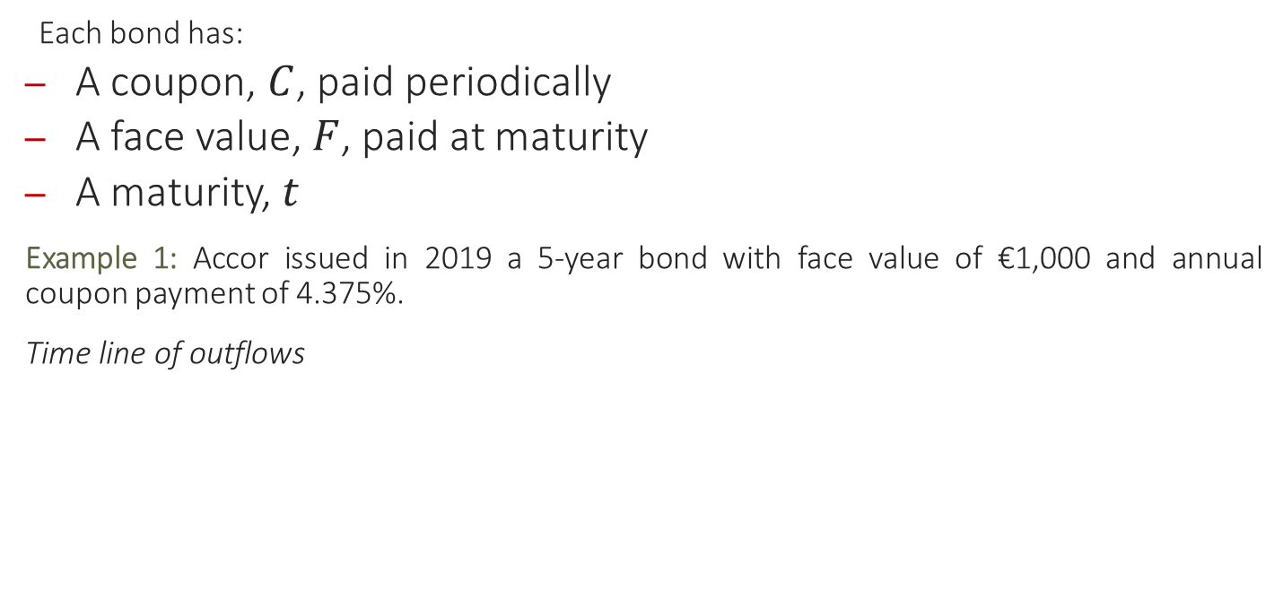











Straight Bond Cash Flows
Each bond has:
A coupon, $C$, paid periodically
A face value, $F$, paid at maturity
A maturity, $t$
Example 1: Accor issued in 2019 a 5-year bond with face value of €1,000 and annual coupon payment of 4.375%.
Time line of outflows
$$\text{C} \text{= €1,000}×4.375\%$$
$$\text{€}1,000$$
$$+$$
Annuity
$$\text{€}43.75$$
$$\text{€}43.75$$
$$\text{€}43.75$$
$$\text{€}43.75$$
$$\text{€}43.75$$
$$t=0$$
$$t=1$$
$$t=2$$
$$t=3$$
$$t=4$$
$$t=5$$

Slide 15
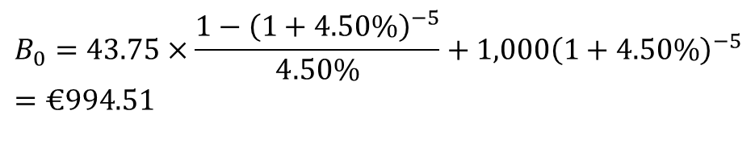
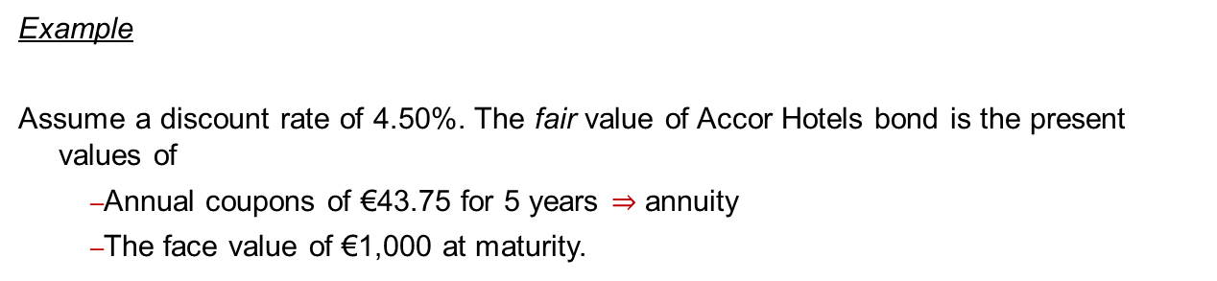
Straight Bond Valuation
The fair value of a financial instrument is the present value of cash flows generated by the instrument in the future.
Therefore the fair price of a bond is the present value of its future cash flows.
Example
Assume a discount rate of 4.50%. The fair value of Accor Hotels bond is the present values of
Annual coupons of €43.75 for 5 years $⇒$ annuity
The face value of €1,000 at maturity.
Annuity
$$B_{0}=43.75×\frac{1−{\left(1+4.50\%\right)}^{−5}}{4.50\%}+1,000{\left(1+4.50\%\right)}^{−5}=€994.51$$

Slide 16
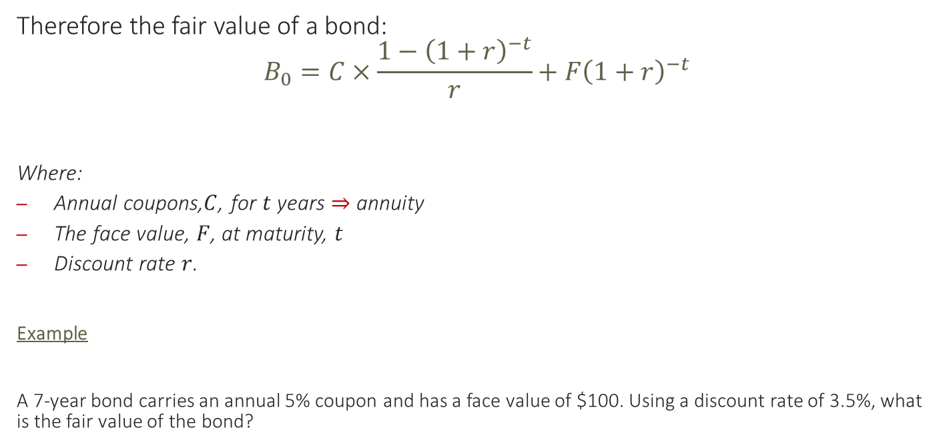
Straight Bond Valuation
Therefore the fair value of a bond:
$$B_{0}=C×\frac{1−{\left(1+r\right)}^{−t}}{r}+F{\left(1+r\right)}^{−t}$$
Where:
Annual coupons,$C$, for $t$ years $⇒$ annuity
The face value, $F$, at maturity, $t$
Discount rate $r$.
Example
A 7-year bond carries an annual 5% coupon and has a face value of $100. Using a discount rate of 3.5%, what is the fair value of the bond?

Slide 17
Convertible Bond
A type of bond which provides the holder the option to convert the debt into ordinary shares at a future date or have the bond redeemed for a cash lump sum . Interest is paid up to the date of conversion/redemption.
Convertible bond example:
A company has 5% convertible bonds, convertible in 5 years time into 50 ordinary shares or they can be redeemed at face value of $100.
So investor receives $5 interest for 5 years
In 5 years time may redeem $100 OR
Convert each $100 of debt into 50 ordinary shares. The shares are worth $2.50 each in 5 years time
In this case the investor is likely to convert the bond into ordinary shares as the conversion will be worth $125 vs the $100 face value

Slide 18
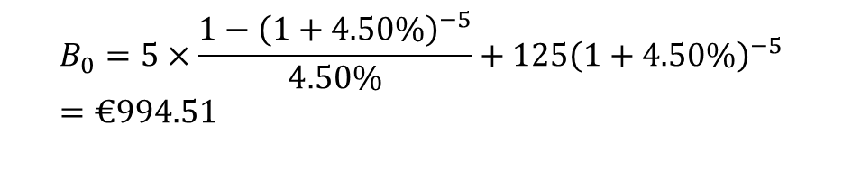
Convertible Bond Valuation
Same principles as a straight bond however the redeemable value will either be the face value OR the value of the future shares.
We use the higher of; the face value and the conversion value
Convertible Bond Example
A company has 5% convertible bonds, convertible in 5 years time into 50 ordinary shares or they can be redeemed at face value of $100. The share price is anticipated to be $2.50 in 5 years time. Use a discount factor of 4.5%.
Redemption value with either be Face value $100 or Convertible value $125. The convertible value is higher so we use this.
Annuity
$$B_{0}=5×\frac{1−{\left(1+4.50\%\right)}^{−5}}{4.50\%}+125{\left(1+4.50\%\right)}^{−5}=€994.51$$

Slide 19
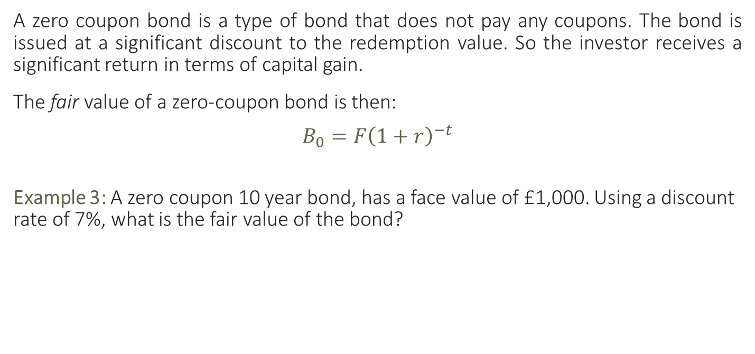
Zero coupon bond
A zero coupon bond is a type of bond that does not pay any coupons. The bond is issued at a significant discount to the redemption value. So the investor receives a significant return in terms of capital gain.
The fair value of a zero-coupon bond is then:
$$B_{0}=F{\left(1+r\right)}^{−t}$$
Example 3: A zero coupon 10 year bond, has a face value of £1,000. Using a discount rate of 7%, what is the fair value of the bond?

Slide 20
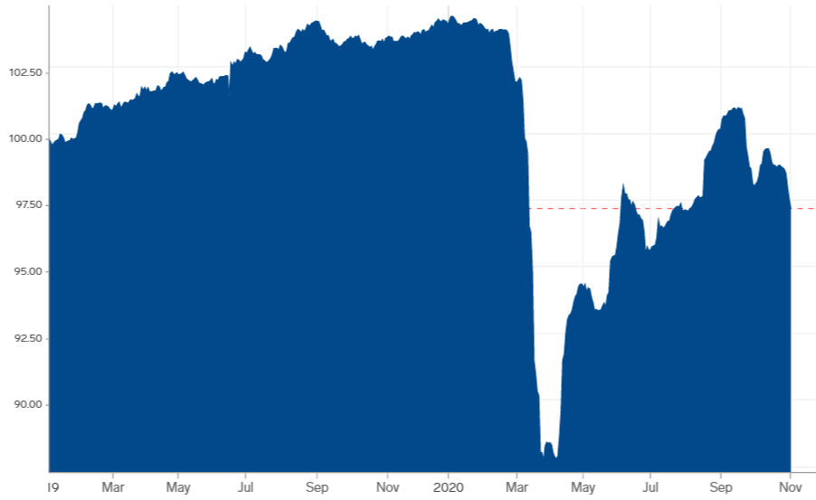
Bond Price Fluctuates
Accor Hotels Bond price over the past year
Source: https://markets.businessinsider.com/
Question: How can the fair value equation be used?

Slide 21




Bond Price
Determined by the issuer
The fair value of a bond is:
$$B_{0}=C×\frac{1−{\left(1+ r \right)}^{−t}}{r}+F{\left(1+r\right)}^{−t}$$
The importance of the valuation equation is to determine $r$, the discount rate at which the present value of the coupons and the face value is equal to the market price.
This internal rate is called the yield to maturity (YTM) on the bond.
$$r$$
$$r$$
$$r$$
Observed in the market
Determined by the issuer
Determined by the issuer

Slide 22
Yield to Maturity
The yield to maturity is the rate of return required by bondholders for buying the bond i.e. the compensation bondholders receive for lending the issuer funds until maturity.
This compensation will vary from bond to bond and over time, for the same bond depending on:
YTM Building Block
Default Premium
Maturity Premium
Yield to Maturity
Short-Term Risk-free Rate

Slide 23
Yield to Maturity
The short-term risk free rate
Captures the overall level of rates in the economy: consumption preference and inflation.
Represents the minimum return expected from an absolutely riskless short-term investment.
Short-term risk free rate = Expected Inflation + Expected Real Rate of Return
Fisher Equation
Expected real rate of return: As economic growth increases, the real expected return increases as individuals have a stronger desire for current consumption.

Slide 24
Yield to Maturity
Maturity premium
Represents the extra compensation for time, in the absence of risk. The difference between longer-term risk free rates and short-term risk free rates
As the maturity of the bond increases, the volatility of the bond increases and should offer a higher maturity premium.
Bonds with longer maturities are more sensitive to changes in interest rates.
US Government Bond Yield on 02 Nov. 2020
(Source: https://www.treasury.gov/)

Slide 25
Yield to Maturity
Default premium
Represents the extra compensation for risk.
Reflects the likelihood of the issuer defaulting on this obligations to pay coupons and the face value.
Bond rating is a scoring scheme used to assess the creditworthiness of a bond.
Credit agencies rate a debt issuer based upon its willingness and ability to repay its debts.
Willingness - the financial discipline that is inherent in a company’s culture and its financial processes.
Ability - a function of a company’s ability to generate sufficient cash flow to pay interest expenses.

Slide 26
Default Premium
Bond Rating
S&P’S | MOODY’S | FITCH | Description
AAA | Aaa | AAA | Highest credit quality; strong ability to meet obligations.
AA+ | Aa1 | AA+ | Very high credit quality; low risk of default.
AA | Aa2 | AA
AA- | Aa3 | AA-
A+ | A1 | A+ | High credit quality; but more vulnerable to changes to business or economy.
A | A2 | A
A- | A3 | A-
BBB+ | Baa1 | BBB+ | Adequate credit quality for now; but likely to be impaired in conditions change.
BBB | Baa2 | BBB
BBB- | Baa3 | BBB-
BB+ | Ba1 | BB+ | Below investment grade; but a good chance the issuer can meet commitments.
BB | Ba2 | BB
BB- | Ba3 | BB-
B+ | B1 | B+ | Significant credit risk; but issuer is currently able to meet commitments.
B | B2 | B
B- | B3 | B-
CCC | Caa | CCC | High default risk.
CC | Ca | CC
C | C | C | Issuer failed to meet scheduled interests or principal payments
Investment Grade
Non-Investment Grade

Slide 27
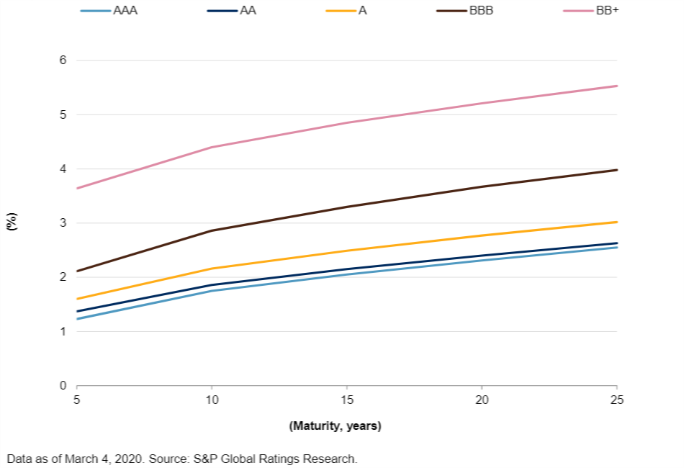
Default Premium – Bond Rating
Bonds with lower ratings, have a lower credit worthiness, i.e. carry more risk and so have to pay a higher yield.

Slide 28

Yield to Maturity
The yield to maturity is the rate of return required by bondholders for buying the bond.
Short-term Risk-free Rate
Maturity Premium Yield to Maturity $⇔$ Bond Price
Default Premium

Slide 29
Estimating the Yield
Example
Company has issued 7% convertible debt, current market value is $107 per $100 bond. The convertible debt can be redeemed in 6 years time or converted into 15 shares per $100 bond. The current share price is $5.50. The share price is expected to increase at an average rate of 6% per annum. What is the investors expected rate of return on the bonds i.e. the yield.
Redemption or conversion…
Use the higher value in the IRR calculation
Formulae:
$$B_{0}=7×\frac{1−{\left(1+r\%\right)}^{−5}}{r\%}+110{\left(1+r\%\right)}^{−5}=\$107$$
Trial and error of discount rates…
5% = $116
10% = $94.84
7% = $107.13
7% is the yield from the debt. This is the true return on debt not the coupon rate

Slide 30
Learning Outcomes Covered
Debt as a source of Long Term Finance
Understanding the key components of Bonds and relevant calculations
Understanding the YTM of a bond
Sources of debt finance

Slide 31
Next Week
Equity

